Slide 1
Unity Fundamentals
Neil Gannon

Slide 2
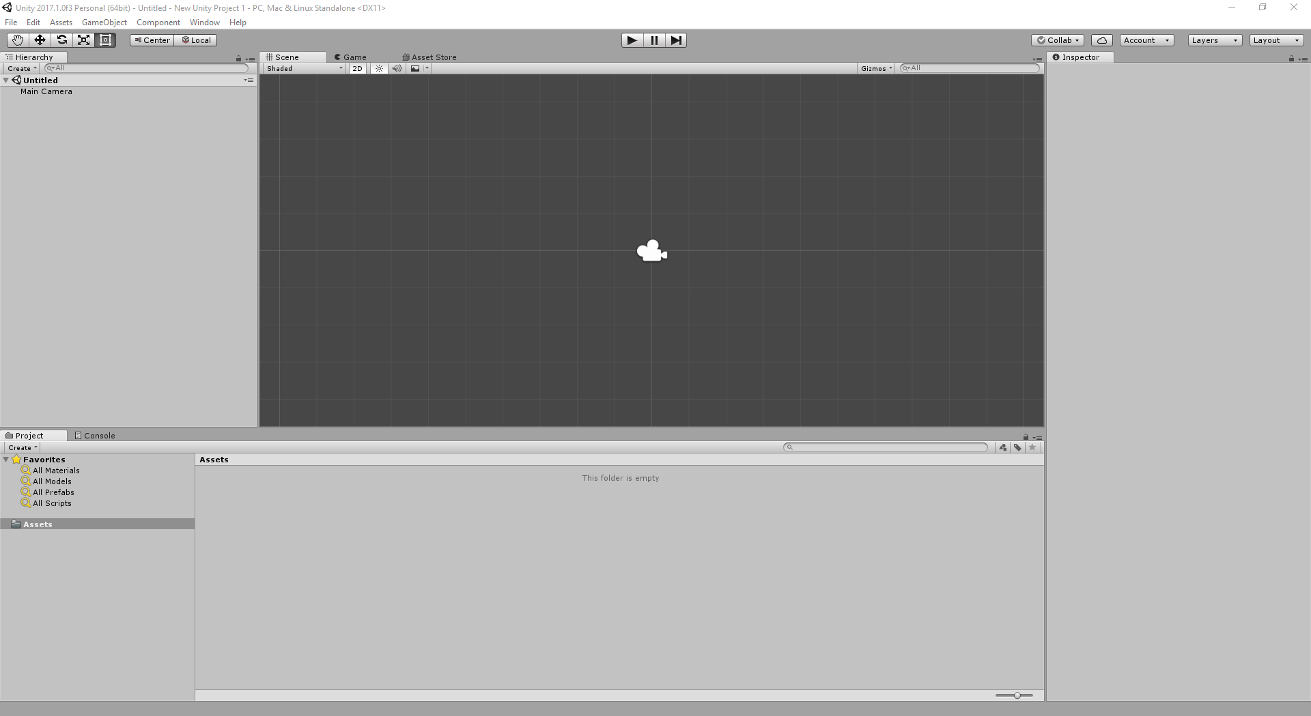
Scene Hierarchy
Scene View
Object Inspector
Selected Folder
Content Folders

Slide 3
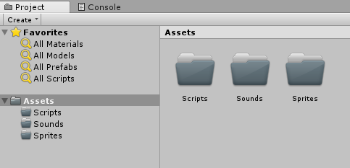
Organizing Content
Always create separate folders for each content type
Before adding any content to the project try to create these folders to make finding things easier later on
We will be adding additional folders as we move forward onto more complex games

Slide 4
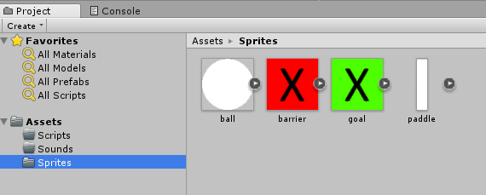
Adding Existing Content
Simply drag and drop your content from windows explorer into the correct folder
Content can be moved in unity by dragging and dropping to the new folder
Assets can be renamed from within Unity

Slide 5
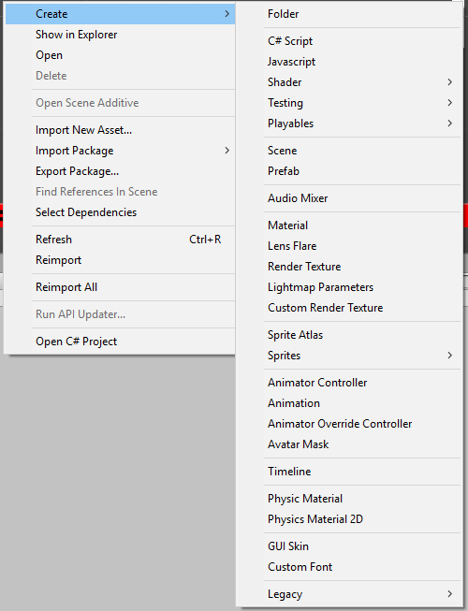
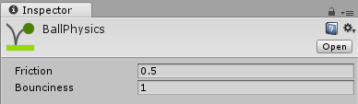

Creating New Assets
Unity provides a wide array of assets that can be created from within the editor
The majority of these are intended for 3D games or advanced features that we will not see in Y1
Of particular interest to us are
Scene (a new level)
Physics Material 2D

Slide 6
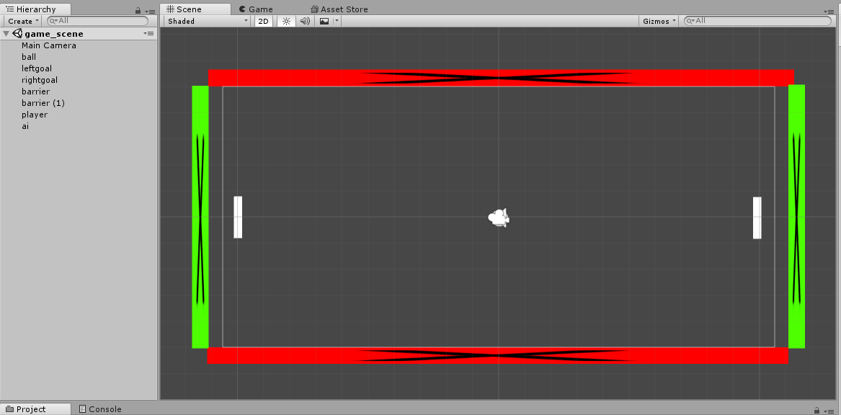
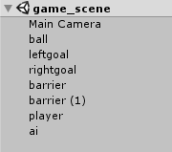
Level Design
Level design in Unity is a very straight forward process
We can simply drag our content into the scene and position it
On the left is the Scene hierarchy
This is the list of object currently in our scene
We should rename object correctly after they have been dropped in
We can also add components to objects in the scene by selecting them

Slide 7
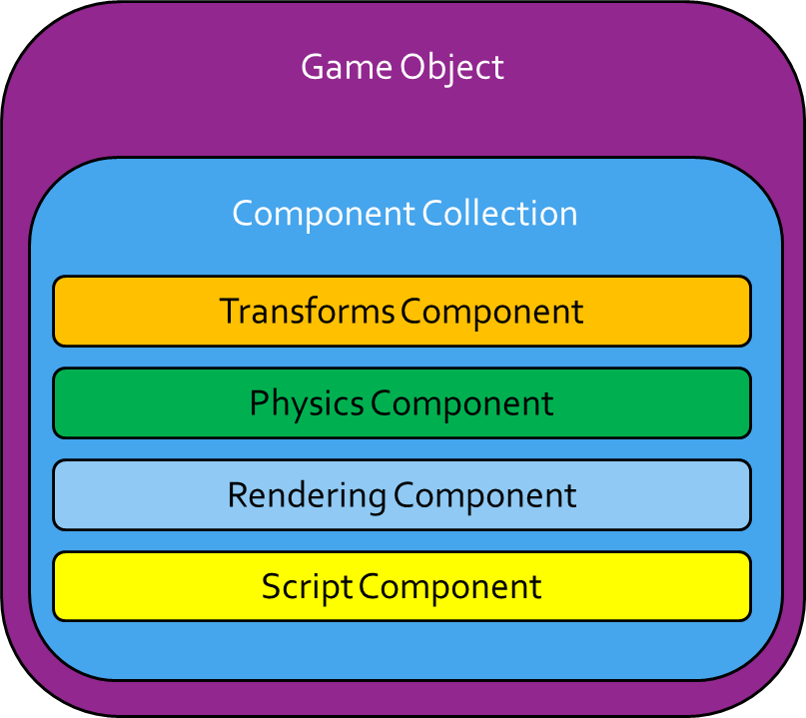
Game Objects and Components
In Unity any object that is placed in a scene is known as a game object
Game Objects have no game related code
Instead they are designed to have components attached to them
Components are single self-contained units that perform a single specialised task.
Commonly known as scripts
We write a script and then attach it to a Game Object
This way we can reuse all of our components among all of our game objects.

Slide 8
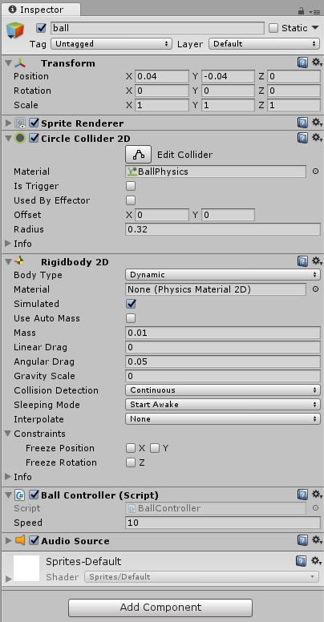
Inspector
The properties of an object will be displayed in the inspector
Select an object and this will populate with all the components and properties of that object
By changing the values in these properties we can directly change the behaviour of an object
Note the components used here
Transform (all objects have this by default),
Sprite, Collider, Rigid Body, Audio
Ball Controller (custom script to control the ball)
We use the inspector to add new components to a game object

Slide 9
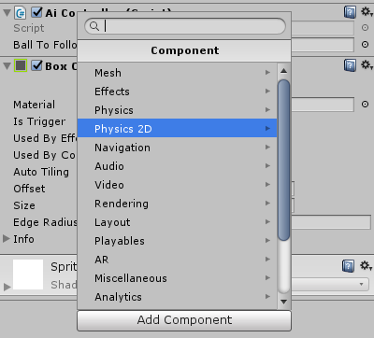
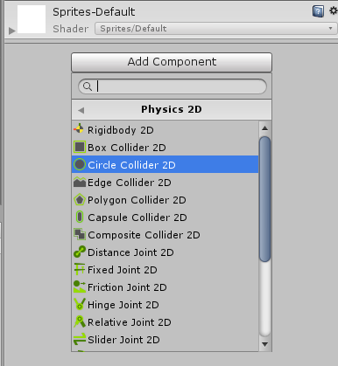
Adding Components
With an object selected we can click the add components button in the inspector
A list of component categories will be displayed
Selecting a category will show all the components available
We are particularly interested in
Physics 2D
Colliders
RigidBody2D

Slide 10

Creating Scripts
Game object wont really do anything by default
Scripts allow us to add game logic to our game objects
To create a new C# script
Right click in the asset section
Select Create -> C# Script
This will create a new file
Name the file appropriately
Double click the Script to being editing it

Slide 11
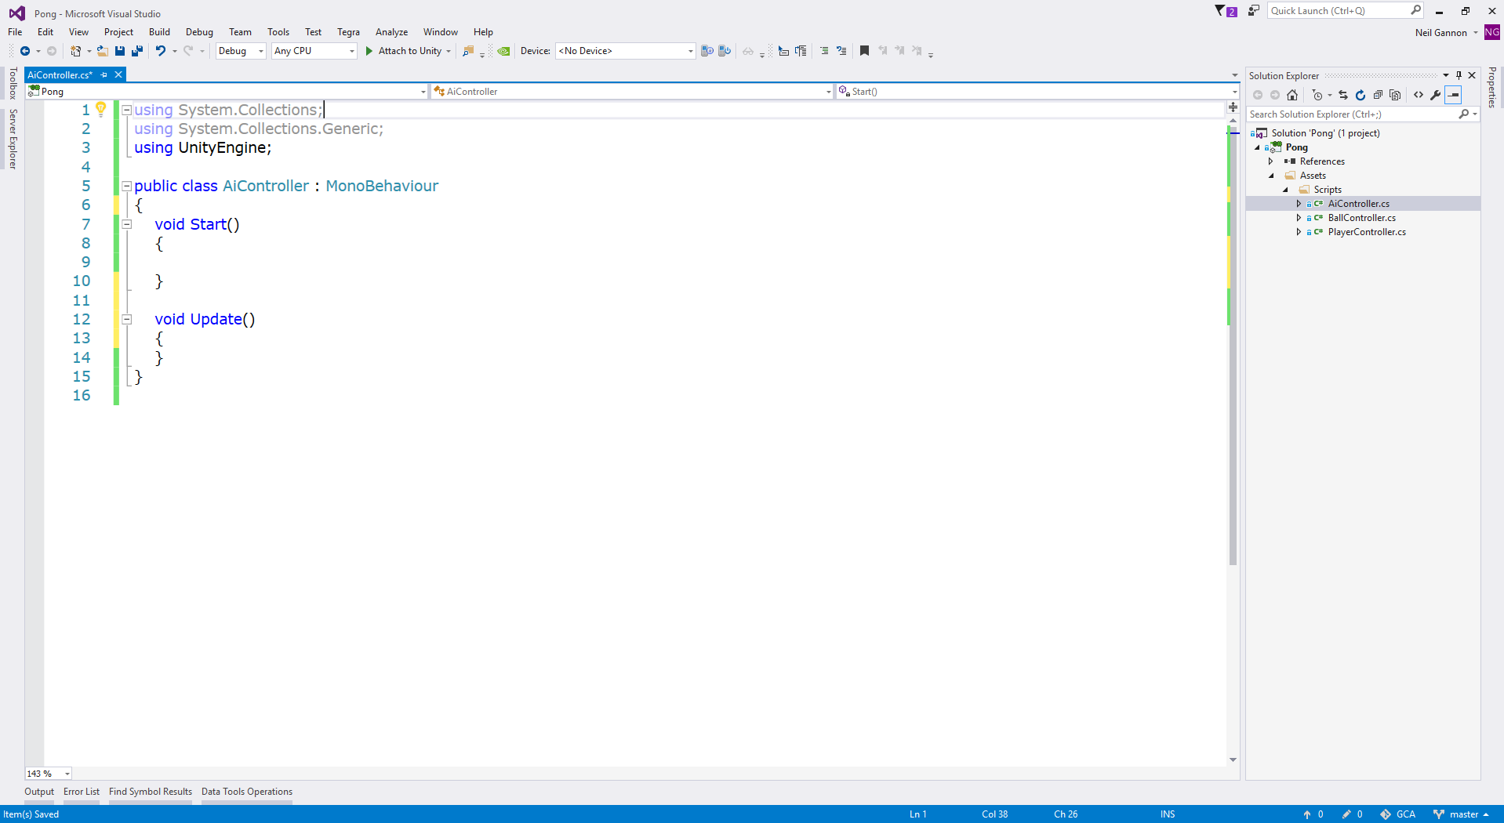
Editing Scripts
C# Scripts in Unity are edited in Microsoft Visual Studio
This is an industry standard tool
Used with all major game engines
By default Visual Studio will be split into two windows
Code Editor (Left)
Code Files (Right)
To open a code file simply double click on it
Ensure your save your files after editing
Save Icon on the top left
Ctrl + S

Slide 12
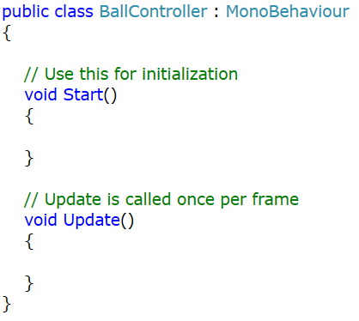
Scripts
The default Script created by Unity is shown on the right
This script has two default methods.
Start and Update
A method is a code block that contains a series of statements
A program causes the statements to be executed by calling the method
Start is called once at the start of the scene
Update is called continuously every 16ms
The time depends on the update frequency

Slide 13
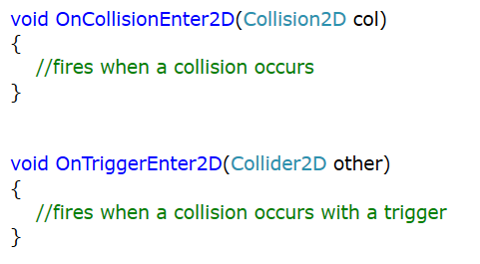
Collision Handling
In Unity we have two types of collisions that can take place
Standard Collision
Trigger Collision
Standard Collision
When objects collide and we want a correct physics response
Trigger Collision
When objects collide and we want code to execute but no physics response

Slide 14
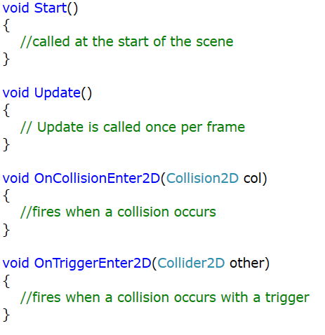
Possible Full Script
Typically scripts will have a lot of methods added to them
The script on the right has most of the default ones added
We will also need to write our own methods
We need to make parts of our code reusable
To do this we create a method and place related code in it
Later we can call this method to execute the code it contains
It’s important to test our code regularly

Slide 15
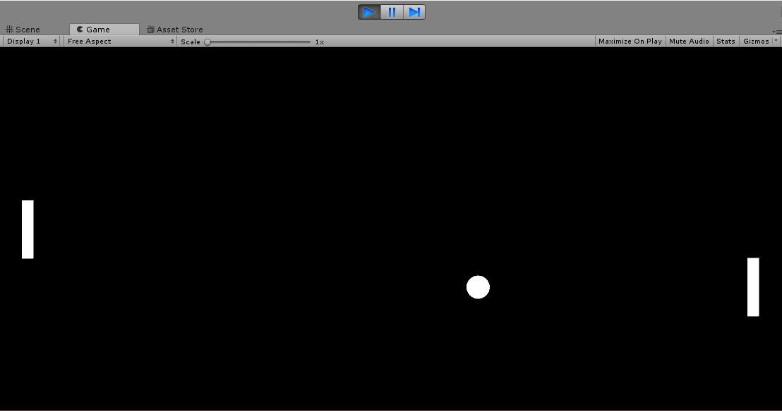
Testing
After saving the code you have written
Switch back to unity and use the play button at the top of the editor to test your work
The game will run inside the editor and work as normal
You will get to see what your code does immediately
If something isn't working as expected go back and edit the code and test again
To stop testing
Click the play button again
Ctrl+P

Slide 16
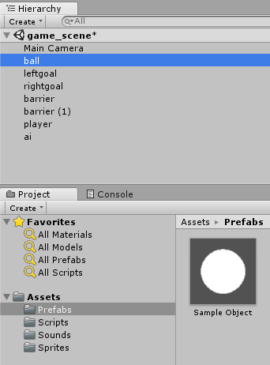
Creating Game Objects
Objects in the scene are not transferrable between levels
When you are happy that an object in the scene is working correctly we want to create a prefab from this (create a configured game object)
Simply Drag and Drop the finished object from the scene hierarchy onto the assets panel and the prefab will be created
This can now be used in any number of scenes

